Slide 1
Barking & Dagenham
Parent Carer Support Group16/11/2022
BCYP Emotional and Physical Health Support
Service Leads :
Mohammad Mohit- Assistant Director of Children Services
Heather Kazingizi – Head of Targeted Services
Joy Coutts – Head of Children Universal Services
Bibi Chummun – CAMHS Service Manager
Nasif Nijabat – Mental Health Support Team in School
Denise Edwards- Clinical Lead Nurse for Specialist Children’s Nursing
Hadasah Lev– Paediatric Therapies Manager
Narelle Jacobs- Paediatric Therapies

Slide 2
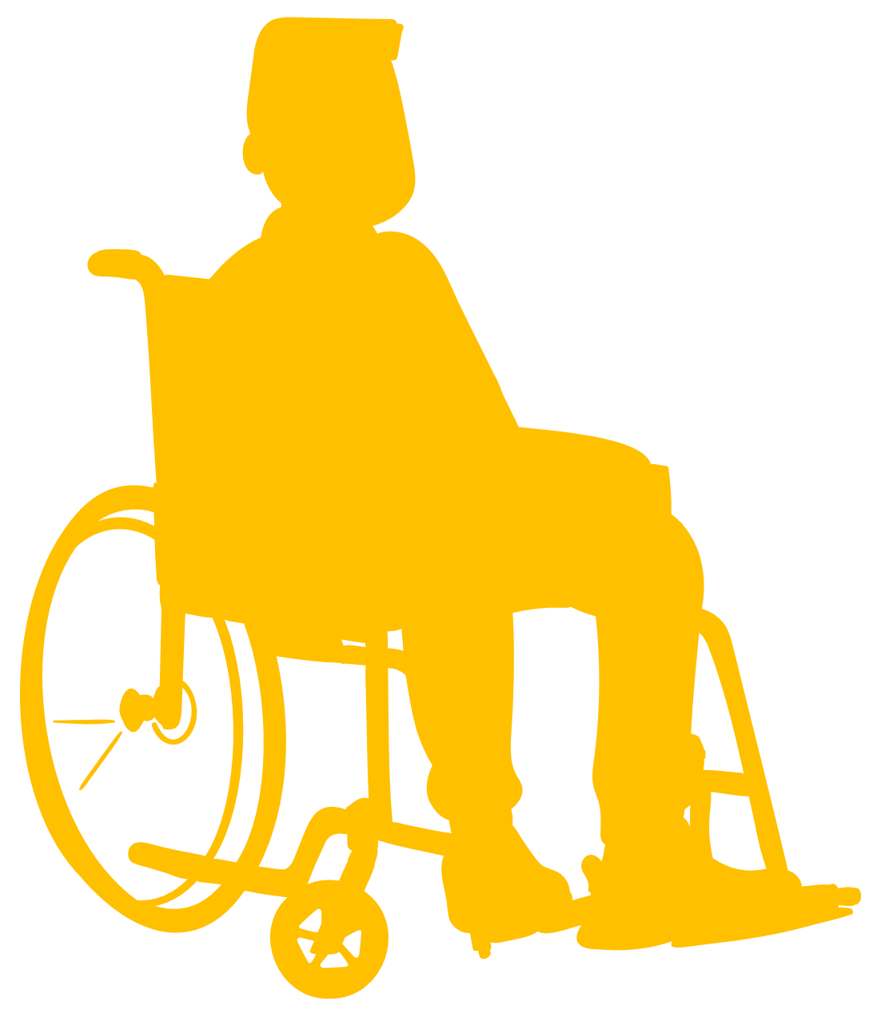
NELFT Services supporting BCYP Emotional Health & Wellbeing in B&D
B&D BCYP Integrated Services
Community
Acute
Integrated Therapy Services (Physio, Occupational Therapy, Speech & Language Therapy)
INTERACT via A&E
YOS /Exploitation
0- 19 Services
Mental Health Support Team in Schools (MHST)
Young People’s Home Treatment Team (YPHTT)
GPs
Community Paediatric
Acute Admissions e.g. Brookside
Child and Adolescent Mental Health Service (CAMHS)
CDC Nursing
LAC
Specialist Nursing(SEN)
Other Sectors e.g. SubWize
Other support services in the community e.g. Early Help
BCG

Slide 3
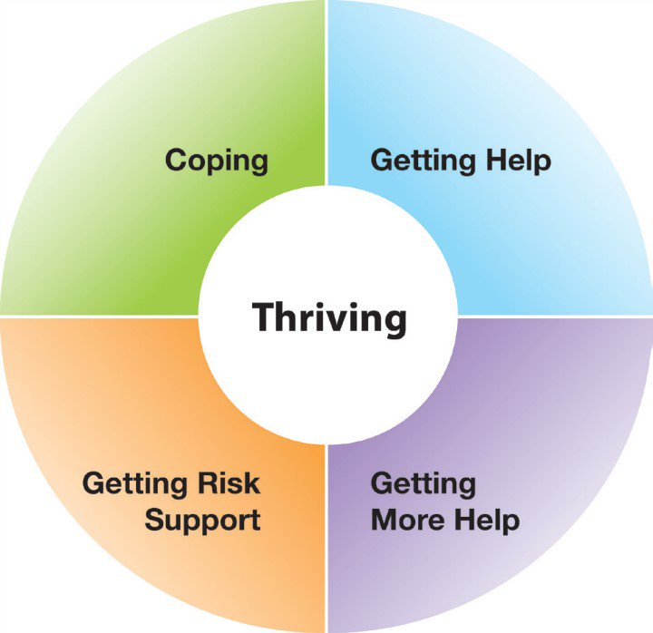
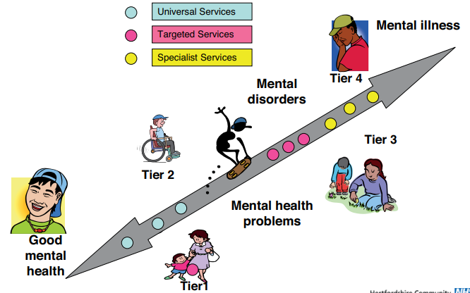
Pathway to promoting positive emotional health and wellbeing

Slide 4
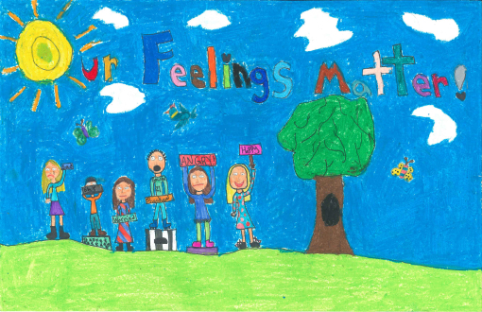
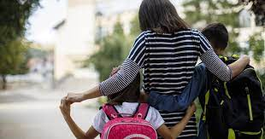
Mental Health Support Team in Schools
In response to the ‘Green Paper for Transforming Children and Young People’s Mental Health’ (2017),our vision is to reach all children who need emotional wellbeing support with mild to moderate emotional difficulties, bridge the gap between education and health care settings.
Ensures that each young person who struggles receives help quicker whilst delivering evidenced based brief interventions working in partnership with schools.
Group interventions
Parent support
Our offer
Tailored interventions
Liaison & consultation
Individual interventions
Staff training
Notes:
What do we do?
We will be based in schools working together with you to support the emotional wellbeing and mental health of children through providing evidence-based support. Our focus is on early intervention and prevention of emotional wellbeing and mental health difficulties such as low mood and anxiety and there are a number of different ways that we do this.
We are flexible in our delivery in line with Covid-19 guidelines and therefore can offer support online and virtually.

Slide 5
Referral Pathways into CAMHS
SPA Admin
Open to CAMHS
Telephone Triage Screening
Full Assessment
Daily MDT Huddle
Treatment Plans /Pathways
Online referral form BDSpCommChildren@
nelft.nhs.uk
Who can refer?
Parents/ Carer/Self
Any professional involved with the child
Pre-consultation sessions
Social Care
A&E (INTERACT/MHD)
Education
GP
Common Presentations
Depression
Anxiety
Phobias
Self-harm
Trauma
Psychosis
Conduct disorders
Neurodevelopmental Assessment
Anger Management
Eating Disorders
BDCAMHSDuty@nelft.nhs.uk
Tel: 03003001751

Slide 6
What does CAMHS offer?
CAMHS Interventions
Risk assessment/
risk management
Brief Intervention
Low/high intensity CBT/health promotion /workshops
Medical /diagnostic/
pharmacological
Neurodevelopmental Pathway
(CBT, Cognitive/ Neurodevelopmental/ assessment)
Emotional Pathway (EMDR, Counselling)
Conduct and Behavioural Pathway
Complex Pathway Care coordination /YOS /Exploitation

Slide 7
CAMHS Interface
CAMHS Team
Psychiatrist
Mental Health Nurses
Psychologists
Family Therapists
Counsellors
LAC Social Worker
Psychotherapists
STAR Workers
Local Authorities eg early help ,social services, mentors, parent support
GP
Acute Healthcare
Tertiary Services
Education
Com. Paediatric
Hospices
YOS/Exploitation
Specialist Schools
Police/Advocacy
Portage
Out of area services
Universal Services
Voluntary organisations
Commissioners
Third sectors
Others based on need at the time

Slide 8
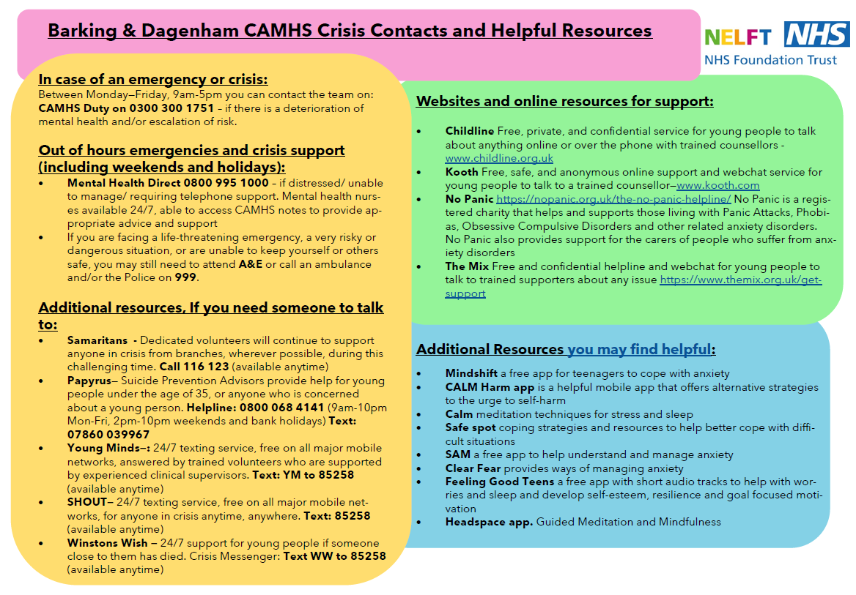
Useful Resources Nij to add

Slide 9
Targeted Children’s Nursing Services
CDC Nursing & Paediatrics
- Assessment and review of children with complex developmental delay
Specialist School Nursing
- Providing nursing service to children attending special schools
- Healthy child programme
- Holistic Assessment
- Early identification of risk factors
- Health Promotion
- Joint clinics
Looked After Children
- Babies, children and young people who are taken in to care
- Health assessments & care plans
- Referrals to specialist support services such as CAMHS, GPs, Community paediatric teams etc.
- Early Help and planning
BCG Team
- BCG immunisation is given to a targeted group of babies in B&D – indicated by the World Health Organisation.
- Support of children and families
- Joint assessments/Pathway working
- Partnership working – including with acute and tertiary teams (GOS)
- Signposting to local services
- Babies under 28 days are offered the BCG once their blood spot result has been received and meet criteria
- The BCG service is offered to Babies resident in B&D, Havering, Redbridge and Waltham Forest

Slide 10
Any questions

