Slide 1
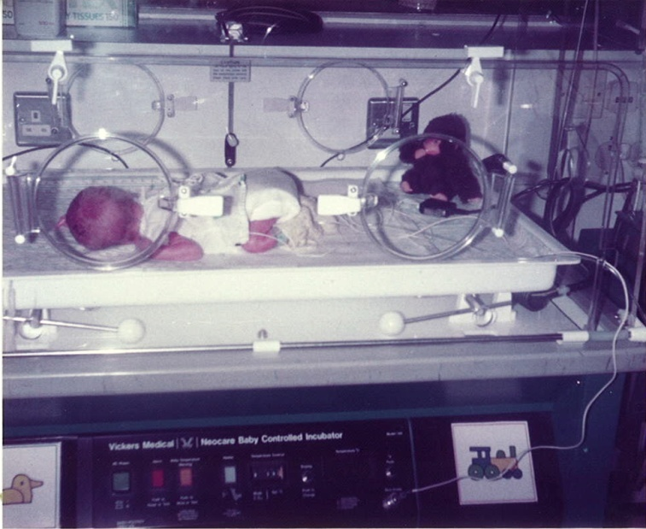
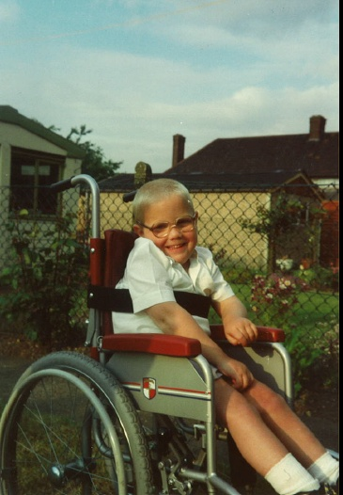
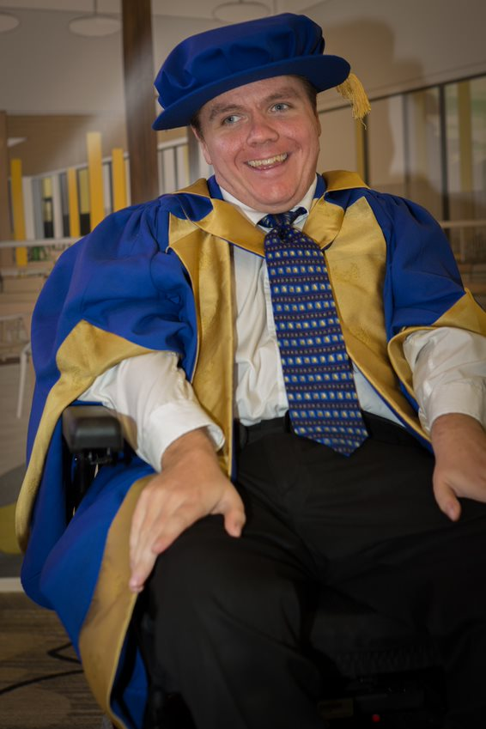
From babe to boy to man:
My journey through childhood, and adolescence to an independent adult
Just Say Parents Forum Conference
14th March 2023
Dr Wesley Scott
E-mail: scottw@uni.coventry.ac.uk

Slide 2
Presentation Overview
In this presentation, we will explore the following:
Who am I?
Why am I here?
My journey
- Babe
- Boy
- Man
The good, the bad and the ugly
Some advice from someone who knows
Hopes, aspirations and the future
My brother the young carer
Conclusions
Summary

Slide 3
Who am I?
I’m Wesley or as many of you may know me, “Sharon’s son”.
I’m 38 years old.
Since birth I have been blessed with the perspective of somebody that has a severe disability (Spastic Quadriplegic Cerebral Palsy).
I have several other conditions (mental health and learning difficulties amongst other things) that are if not entirely, at least in part, caused or exacerbated by my cerebral palsy.

Slide 4





Who am I? ctd….
Despite all of that, I live a full, active and independent life assisted by lots of lovely people and many organs of the state (local authority (London Borough of Barking & Dagenham (LBBD), National Health Service (NHS), Department of Work and Pensions (DWP), Christies Care and my family among others). I have a comprehensive care package that meets all of my needs, this helps me to live safely and independently in the community in my own 2 bedroom council flat.
My full and active life has led to me completing a PhD in 2018 which looked at how we can better include people with disabilities in the design and evaluation process.
I also volunteer with many agencies, such as Transport for London (TfL) and the NHS to offer the patient/service user perspective. I also am a Visiting Researcher at Coventry University, although, sadly, I no longer work with Coventry in terms of explaining the service user perspective, this is something I miss but I do a similar voluntary job with TfL which involves me talking to bus drivers and explaining the difficulties I have when accessing public transport.

Slide 5
Why am I here?
Jaimie thought that it would be nice if I came and talked to you today about my journey through life and how I got to where I am today (an independent young man who has a severe disability, who’s done pretty well for himself). It is hoped that this may inspire you and help you think about your child’s future in a positive light.
I will try and share with you:
Some of the highs and lows of my journey.
The important role my Mum played.
The skills I’ve learnt.
The importance of being a self-advocate.
The important/inspirational people I've met on my journey and how they helped me.
What you can learn from me.
Please note, journeys are always very personal things, this is my journey, it will undoubtedly be different from yours and other peoples’ but you may be able to identify some common themes that may relate to yours.

Slide 6
My Journey-Babe
I was born on the 11th June 1984, I was one of two (twins).
We were born 9 weeks premature and I weighed 3lbs 14oz, little more than a bag of sugar.
I wasn't diagnosed with cerebral palsy until I was 6 months old and it’s fair to say it was a struggle for Mum bringing up 2 babies at the same time, let alone one who was severely disabled.
The doctors’ told Mum that the prognosis for me wasn’t good but to be fair they didn’t really know, so they told her to expect the worst.

Slide 7
My Journey-Babe ctd.
As you may expect, I was quite a sick child with numerous hospital visits and operations.
It was a struggle for Mum to cope with my diagnosis made worse by the fact that my biological father was in the army and so away a lot.
She had good parents that helped her out. We moved back to Barking and Dagenham after a few months in army quarters and lived with them while we waited to be re-housed, eventually moving into a flat.

Slide 8
My Journey- Babe ctd.
We had lots on input from services such as Physiotherapy - I learnt to swim at the age of 2.
When it came to nursery, my Mum was ahead of the times. She wanted me to go to a mainstream nursery but I needed to be assessed for my statement of special educational needs (as you know it an Education Healthcare Plan or EHCP). So, it was agreed that I would do 2 days a week at the nursery in the local special school (then Faircross) and the other 3 days I would spend at Eastbury day nursery.

Slide 9
My Journey-Boy
Eventually, it was decided I would go to a mainstream school with 100% support.
Unfortunetely, the Head Mistress at my first infant school didn’t promote inclusive practice and I remember the first time I was ever discriminated against when she told my Mum that because I couldn’t stand up I couldn’t sing in the choir. Needless to say, my Mum didn't take very kindly to that and decided a change of school was needed.
Luckily, by then, I had moved house and would shortly move to Dorothy Barley Primary School.

Slide 10
My Journey-Boy ctd.
Luckily, the Head Master and SENCO were ahead of the times and I really enjoyed primary school. They even adapted the school for me so I could get around safely. They also encouraged me in the things I enjoyed such as music, Information and Communication Technology (ICT) etc.
When I was 11 we moved into a more accessible house. This all occurred as a result of toilet gate. Basically, one day I had an upset stomach and couldn't get to the toilet as the house we were living in only had a toilet upstairs. I remember my Mum very forcefully telling the housing department to explain to me why I couldn't access the toilet, then she handed the phone to me. The next thing I remember loads of professionals came round and it was agreed we would move.

Slide 11
My Journey-Boy ctd.
I also moved to secondary school, going to the local mainstream (Eastbrook). I still had 100% support and involvement with many services such as physiotherapy.
It was fair to say I encountered lots of barriers at senior school, the Head Master had preconceived ideas about what disabled students could achieve.
Some teachers were down right rude to my mother and to me. I remember being told that I couldn’t do most of the technical subjects for various different reasons or go into the drama studio because I might mark the floor with my wheels. I remember lots of phone calls between my mother and the borough architect to sort that one out.
When it came to my GCSE’s, Mum had a real fight on her hands, she knew that if I took fewer GCSE’s I might pass them well. She also knew I would need extra support to do this, which eventually she got.

Slide 12
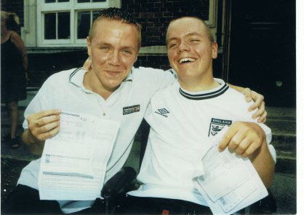
My Journey-Boy ctd.
Also, my subject teachers and Mother had to battle with the Head Master’s attitude i.e. I would only do the lower level exams.
They knew I was capable of more, eventually, they got their way and their faith in me paid off. I got 8 GCSE’s A-C, not bad for someone who it was thought wouldn't achieve.
Outside of school I had many hobbies and had a well-rounded childhood. I attended the local Cubs and Scouts group, that was a first, they hadn’t had anybody in a wheelchair before.

Slide 13
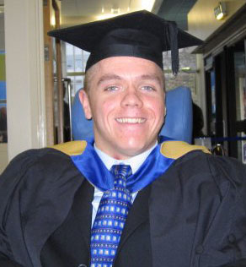
My Journey-Man
When I was 18 unfortunately due to inaccessible provision in the local area I went to a residential college in Coventry. For me, looking back, this was the only decision I could make and despite the fact I succeeded academically I found it really difficult as it wasn’t a mainstream college and I wasn’t with able bodied peers. Consequently, I struggled to make friends and adapt to the environment but it did help me to become a young, independent man.
In 2003, I got a place at Coventry University to study Computing . Thanks to many wonderful people and a lot of hard work, in 2007, I graduated with a first class honours degree.

Slide 14
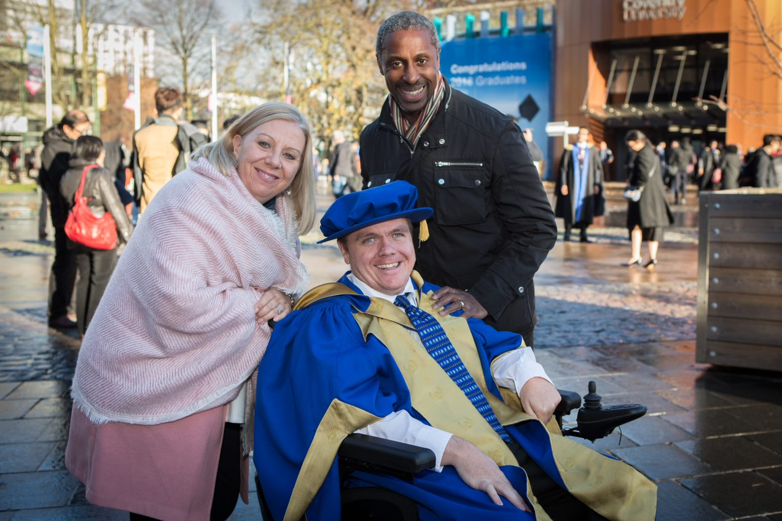
My Journey-Man ctd.
From 2008 -2018, I studied for a PhD in the School of Art and Design at Coventry University.
My PhD examined how we can make the research process more accessible for those with disabilities.
In addition to the above, I am a published author; I’ve published 4 papers about my research and spoken at many different conferences.
Of course, I couldn’t do this without having access to appropriate care and support. I'm proud to say that LBBD adult social care, fund a comprehensive package which means I can live safely and independently. This is funded through individual budgets, giving me choice and control.

Slide 15



The good, the bad and the ugly
Okay, I’ll be honest with you, my life is good on the whole; I have a supportive family, some great friends and a lovely girlfriend (more on that later), the state support me both through social care, the provision of an electric wheelchair from the NHS and there was provision of some academic support whilst I was at university.
But if I said my life was fair I’d be a liar. I have been sworn at, shouted at, threatened, verbally abused, discriminated against etc. Not because of who I am but what I am i.e. a disabled man. Oh yeah, try waiting for 30 minutes whilst it was raining heavily to get on a bus, yes I was very wet and cold. Mainly thanks to my Mum, I don’t give up, a person’s ignorance is not my problem, it’s theirs. That doesn’t mean I don’t cry, scream, shout and wish I wasn’t around some days but it does mean I somehow find the strength to get through.

Slide 16

Some advice from someone who knows
Life’s not fair get used to it.
Life’s not easy as a disabled person.
Life is unique as a disabled person; I have a different perspective that I wouldn’t have if I didn’t have my disability.
My Mum’s been my inspiration and my family and friends have been my support.
Services won’t give you all you want, it’s about negotiation and relationship building.
Monkey see monkey do - I learnt from my Mum how to take on difficult situations and how not to lose it, even if I felt angry. Your children will learn from you, so be positive, upbeat and set a good example.

Slide 17
Some advice from someone who knows ctd.
Life is a gift, live it.
Your children are loaned to you, only for a short while, do the best you can.
You and your child will become the expert in their condition.
Don’t be aggressive, be assertive, there is a difference.
You don’t want people’s sympathy but rather their empathy.
Be an agent for change.

Slide 18
Hopes, aspirations and the future
Short-term aspirations:
To continue being an uncle to my nephews Zackary, Harrison and my niece Piper.
To continue being an advocate and a role model for differently abled people.
To have a positive impact on the life of disabled people by being an agent for change.

Slide 19
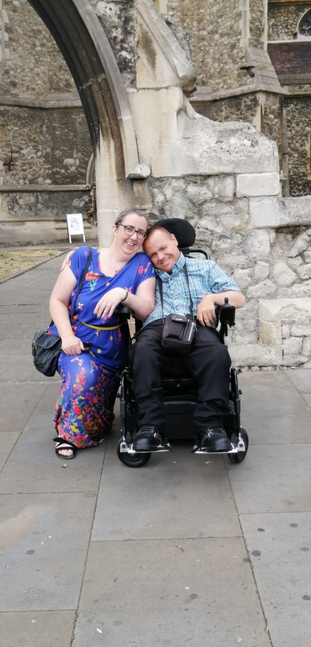
Hopes, aspirations and the future ctd.
Long-term aspirations:
To become an ordained Minister within the Baptist Church, possibly a chaplain within healthcare or education.
In January 2022, something happened that I thought was never possible, I met Helen and despite the complexities of the relationship we make it work. I love her to bits and we help and support each other, it’s more than I could have ever dreamed of.

Slide 20
My brother the young carer
As I mentioned earlier, I’m a twin so my disability didn’t just impact me and Mum. It had a substantial impact on my brother.
We didn’t know it at the time but he was what would be termed today a young carer.
A young carer is “… someone aged 25 and under who cares for a friend or family member who, due to illness, disability, a mental health problem or an addiction, cannot cope without their support.” (Carers.org, 2023)
Young carers were not really talked about when I was growing up and not really publicised as much. Today, as some of you may know that’s not the case, there is a lot more support available.

Slide 21


My brother the young carer ctd.
If your child has siblings or you know somebody who is a young carer, I would advise you to contact Barking and Dagenham Young Carers Service.
They can be contacted using the following information:
Telephone: 020 8593 4422
E-mail: carers@carerscentre.org.uk
Website: http://www.youngcarerscentre.org.uk/
You can self refer, you just complete a simple form on their website then someone will get back to you as soon as possible.
Young carers offers the opportunity for a young person to take a break from their caring responsibilities.
They do a wide range of activities, including, arts and crafts, trips out, residential holidays to name but a few.
We didn’t recognise the impact that my disability had on my brother, but young carers helps young people to recognise what they are and take care of themselves as well as who they care for.

Slide 22
Conclusions
My Mum has been the driving force behind the man I am today.
My family have provided love and support.
My Mum is the best advocate I know.
My brother was a young carer who needed support.
Life as a disabled person is not easy or pleasant at times, but it can be done, so don’t give up.
It’s important to build effective relationships with services.
People won’t listen if you’re aggressive; they might listen if you’re assertive. Remember there’s more than one way to skin a cat.
Life is what you make it. As a parent of a disabled child you will make hard choices, make sure they are the right ones, not just for you but for your child as well.
This was my journey, please remember journeys are very personal and no one journey can ever be the same, but I hope by sharing my journey you’ll see some common threads and it will give you some inspiration.

Slide 23
Summary
So in this presentation, we have looked at:
My journey
- Babe
- Boy
- Man
The good, the bad and the ugly
Some advice from someone who knows
Hopes, aspirations and the future
My brother the young carer
Conclusions

Slide 24

Thank you for listening.
Please feel free to ask me anything you like, I’m fairly open and I don’t offend easily

Slide 25
References
Barking and Dagenham Carers (logo) [online] available from <Barking & Dagenham | Young Carers (youngcarerscentre.org.uk)> [21 February 2023]
Carers.org ‘About Young Carers’ Carers Trust [online] available from <About Us - Caring as a Young Carer | Carers Trust [20 February 2023]
Christies Care logo [online] available from <Rated OUTSTANDING by the CQC | Live-in Home Care around the UK (christiescare.com) >[17 February 2023]
Coventry University logo [online] available from <http://www.coventry.ac.uk/Global/Smarter%20Households/Coventry%20University%20Logo.JPG > [29January 2016]
Department for work and Pensions logo [online] available from <Department for Work and Pensions - GOV.UK (www.gov.uk)> [ 17 February 2023]
London Borough of Barking and Dagenham logo [online] available from <Welcome to Barking and Dagenham | London Borough of Barking and Dagenham (lbbd.gov.uk)>[17 February 2023]

Slide 26
References ctd.
Monkey image [online] available from < http://advisoranalyst.com/glablog/wp-content/uploads/2016/01/monkey-see-1.jpg> [29 January 2016]
NHS Logo [online] available from <About NHS login - NHS (www.nhs.uk)> [17 February 2023]
Neutral emoticon [online] available from <https://pixabay.com/static/uploads/photo/2012/04/05/01/03/emoticon-25505_960_720.png> [29 January 2016]
Sad emoticon [online] available from <http://previews.123rf.com/images/yayayoy/yayayoy1103/yayayoy110300002/8950362-Sad-emoticon-Stock-Vector-sad-face-smiley.jpg> [29 January 2016]
Smiley emoticon [online] available from < http://3.bp.blogspot.com/-Di5r-ZaVWXM/U5VGVq_PuDI/AAAAAAAAIBs/2fW-tgbxnx0/s1600/happy-smiley.png> [29 January 2016]
Young Carers (logo) [online] available from <Barking & Dagenham | Young Carers (youngcarerscentre.org.uk)> [21 February 2023]

