Slide 1


Just Say annual Conference 14th March 2023
Welcome

Slide 2

Let’s be kind let’s work together let’s make a real difference
Apologies today
Emma, Khadija, Mmataz &
Rebecca

Slide 3
Our Programme
What Just Say has been doing over the last year – Donna & Jaime (Co-Chairs)
Welcome from the Stallholders
LATEST on Barking & Dagenham services & plans – Elaine Allegretti & Jane Hargreaves
TABLE TALK
Refreshments & Marketplace
From Babe to Boy to Man - Dr Wesley Scott
Empowering Parents Empowering Communities - Nikki, Mariama & R’chelle
TRINITY ROCK BAND performance
Lunch
Recap & Thanks - Donna & Jaime.
End at 2 - PLEASE give us your Feedback.

Slide 4

Highlights in Our year
Partnership with
Strengthened the Steering Group by adding a new member to the original 5
Updated all our Policies
Restarted Face To Face meetings
Continued Monthly meetings with the Council
Kept in touch with our members via our FaceBook Group and by Text
Networked with London and the
Started attending the SEND BOARD – a strategic level meeting
Redesigned and relaunched website www.justsayforum.online

Slide 5
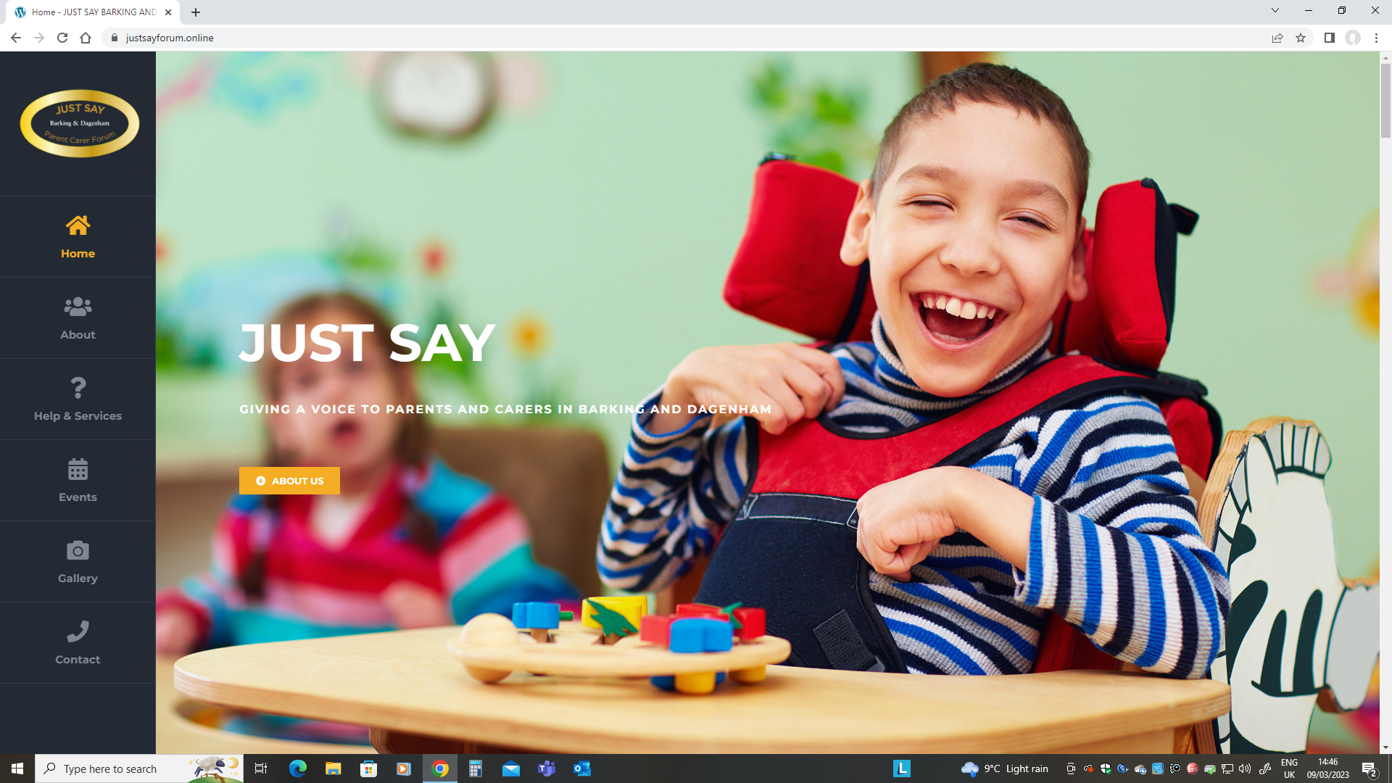
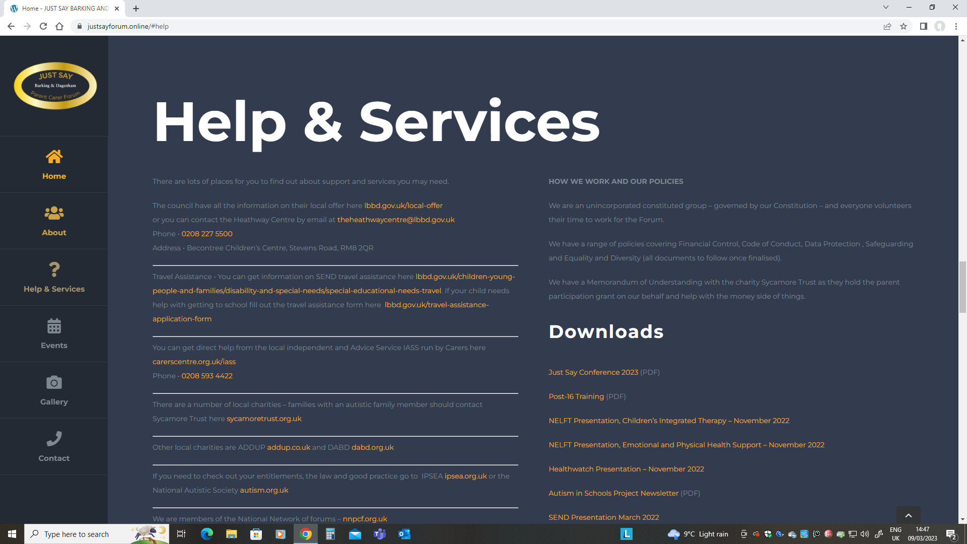
Visit our website www.justsayforum.online
View our upcoming Events
Check out our Policies
Find useful Presentations from partners
See records of our Meetings
Find links to Help & Services
Become a Member
Contact Us

Slide 6

Highlights in Our year Project work :ais
Pilot project Autism in Schools (AIS)
3 SECONDARY SCHOOLS
Barking Abbey, Jo Richardson and Sydney Russell
In partnership with AET – specialist OT sensory walkthroughs, training and setting up coffee mornings for parent carers. Forum leads: Rebecca & Emma. They are at an evaluation meeting today – Report to follow. Big time commitment over 150 volunteer hours.
Parent carers have told us that they have a better relationship with their school staff and have been able to offer each other peer support. Proud to be one of the successful London projects.

Slide 7






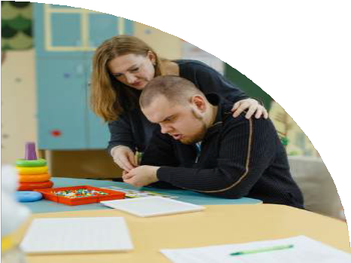
BY REBECCA TANSLEY
BARKING & DAGENHAM PCF
We are delighted to provide a second update from one of our Parent Carer Forum leads on the work she has been doing as part of the project to strengthen the parent carer voice and strengthen relationships between parents and carers and their schools. This includes taking part in training with school staff, and running coffee mornings with parents and carers to better understand their concerns, and begin to build improved communication.
“We have gained some valuable information from our coffee mornings with parents and schools have received and responded positively to their feedback.
In one school the parents gave very positive feedback saying they had good communication with the school and know how well their child is doing. The parents asked the school to consider the introduction of a clip-on tie for uniform, and also the inclusion of ARP students in the school newsletter so that the whole school community are aware of the ARP students and their achievements. We passed this information back to school, and school appreciated hearing the parents' views and stated this is something that is very important for them. The school are in contact with the uniform providers to try and arrange the introduction of a clip-on tie and are planning the newsletter for the new academic year in September.
In another school we heard more mixed reviews from parents about communication between them and the school. For example, the teachers do not always understand how autism affects each child differently and some parents found that their child was being given detention or isolation for issues that they cannot help, examples of this given by parents was
a) not being able or wanting to wear the school blazer, b) forgetting pencil case or equipment, c) being late due to issues with sleep or a problem that has occurred in the morning, d) detention for not completing work when extra time is needed to process the information. This feedback has been given to school and is being considered. All parents really enjoyed the coffee morning, felt it was a place to have their voices heard and are looking forward to the next one.
I think the information we gathered from the two coffee mornings shows the importance of the Autism in Schools project and how it can help improve the educational experience of all children with SEND and their families. It is opening the lines of communication between parents and schools so that their voices and concerns can be heard and addressed. It has meant that PCF representatives have been able to pass on information from training, for example about reasonable adjustments, what they are and how schools can implement them. PCF representatives can also signpost parents to other services and help in the local area which parents may not be aware of without these coffee mornings.
I feel that the training being offered through the project will give all school staff a better awareness, knowledge and understanding of the students' needs and how to meet those individual needs so that each child can progress and not become isolated or excluded from education.”
Just Say article in one of the AIS project newsletters.
Thanks to all who have participated.
And special thanks must go to Marianne McCarthy who supported us tirelessly at the start of this work and was a great ally. We were very shocked and saddened by her sudden death.
Autistic pupils often face significant barriers to learning within the educational environment. These can be overcome by ensuring we create supportive teaching environments that are structured, consistent, and respectful of differences

Slide 8

We listened
At our Open Forum in October, we talked about a range of key topics but especially about hopes & aspirations for our young people.
What would help them in preparing for adulthood and leading fulfilling lives?
Jaime(Co-Chair) has taken the lead on this area and JUST SAY has paid for POST 16 Training from IPSEA to better inform us all. What should we expect? We are at the start of a conversation with key people about better services as they are VERY much needed.
And we know our keynote speaker today (Wesley) will inspire you all and is living proof of what an attitude of “no limits” can achieve.
At our Open Forum on Health in November we had several key local health colleagues join us as well as Healthwatch & the Health Strategic lead for CONTACT.
We have also worked with local officers on the revised documents for the Education, Health and Care Plan (EHPC) Review, getting ready for the next Local Area Inspection, alternative provision and the urgent need to improve the LOCAL OFFER.

Slide 9


We need you!
Come along to our open meetings – we plan to host one every term
Reply to our requests for your views and to fill out surveys when we post on FaceBook
Tell us your ideas about where and how things can be made better
Help us run the Parent Carer Forum. We have 4 vacancies on our Steering Group and also 2 places for allies ( as non-voting members)
TODAY on your tables tell us what the important issues are for you and your family. Please share your ideas!
Remember we are representing ALL families in BARKING & DAGENHAM where a child or young person is aged 0-25 years living with any disability or additional need.

Slide 10

WE ARE PART OF A much BIGGER FAMILY
Changes to the way that the Local Area Inspections are going to be done (Ofsted)
How vital it is to support the mental wellbeing of parent carers, especially those volunteering on forums and trying to make that difference in very challenging times
The expected changes to SEND law - doing away with the postcode lottery, creating a Local Inclusion Plan and changes to EHCPs
IT MEANS WE HAVE A POWERFUL VOICE

Slide 11

We hope you will get a lot out of today. We are delighted to see so many old friends and some new faces too
We are grateful to so many people who help us run the forum – and for those that give their precious time
We want to thank Fazilla Amide – London Rep – as she stepped back this year after many years of amazing service
And our heartfelt condolences go to our colleagues in Havering who lost the wonderful Karen
Let’s start by hearing from our Stallholders…

Slide 12

Nikki, Mariama & R’chelle tell us all about their new project
EPEC

Slide 13
Thanks to all.
Speakers, the Band, stallholders, volunteers, caterers as well as Chris and his team at the Football Club.
Help us improve by giving us your feedback.
Please join us in the year before the next conference.

