Slide 1
B&D MENTAL HEALTH SUPPORT TEAMS (MHST) Nasif Nijabat Service Lead Ceren Devitt and Toni Quick Senior Therapists and Supervisors

Slide 2
What is B&D MHST?
In response to the ‘Green Paper for Transforming Children and Young People’s Mental Health’ (2017), NHSE, NHSI, DfE, and MH partners developed ‘MHSTs’
We aim to bridge the gap between education and health care settings
Early interventions for mild-moderate MH issues delivered by Education Mental Health Practitioners (EMHPs)
Helping school staff to provide a ‘Whole-School Approach’ to MH and wellbeing
Link with local CYP MH services
Collaborating with MH partners, CYP, parents/carers & education workforce

Slide 3
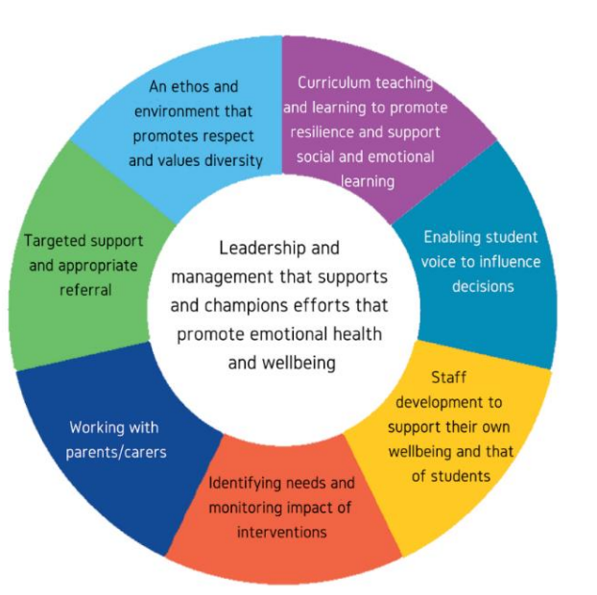
What is our ambition?
An integrated offer for schools
Adopt a ‘whole schools approach to mental health

Slide 4
Suitability Criteria
Below CAMHS threshold
Mild/non-complex difficulties
Primary-aged: Anxiety/behavioural difficulties as main presenting problem
Secondary-aged: Low mood/anxiety as main presenting problem
Definable problems and goals
YP has acess to thoughts and feelings
YP/Parent is motivated to engage with the approach (willing to carry out reading between sessions and home-based tasks)
Available for weekly short-term interventions

Slide 5
Suitability Criteria

Slide 7
Which B&D schools do we currently cover?
Secondary schools:
Primary schools:
Robert Clack
Eastbury
Eastbrook
Mayesbrook Park
Jo Richardson
The Warren
Barking Abbey
Dagenham Park
Hunters Hall
Rose lane
Thames View Infants
Godwin Primary
James Cambell
Manor Junior

Slide 8
MHST Testimonial
“The Barking and Dagenham MHST started their pilot service here at JRCS and we have been exceptionally grateful ever since they started. The open and holistic approach taken by the team allowed us to tailor the service to the needs of our school which is a vital element of excellent mental health support. Prior to their work starting we had long in-school counselling waiting lists, with gaps in provision that this service could truly fulfil. Now, with the MHST intervening with students presenting with low mood or anxiety, we have managed to fill a gap and ensure the young person is accessing the best service for them. Importantly, this has significantly reduced our counselling waiting list to leave room for drop-ins for students who have experienced something urgent that they would benefit from discussing with a counsellor. The MHST has taken organised approach and utilises a bi-weekly ‘Clinic’ where pastoral staff in school can present concerns and young people to the MHST to identify the support they need. Finally, the MHST has also offered us; supervision for our child protection team, staff training for teachers and support staff, workshops for groups of young people on targeted areas (exam stress, transition) and finally, working with parents supporting in meetings and offering coffee mornings. We cannot imagine not having the MHST now in school and highly recommend working closely with them to set up this excellent provision across all borough schools.”
Olivia Draisey, Senior Mental Health & Wellbeing Lead, Jo Richardson Community School

Slide 9
Pupil/Parent/Carers referral pathway
Pre-referral meeting with MHST

Slide 10
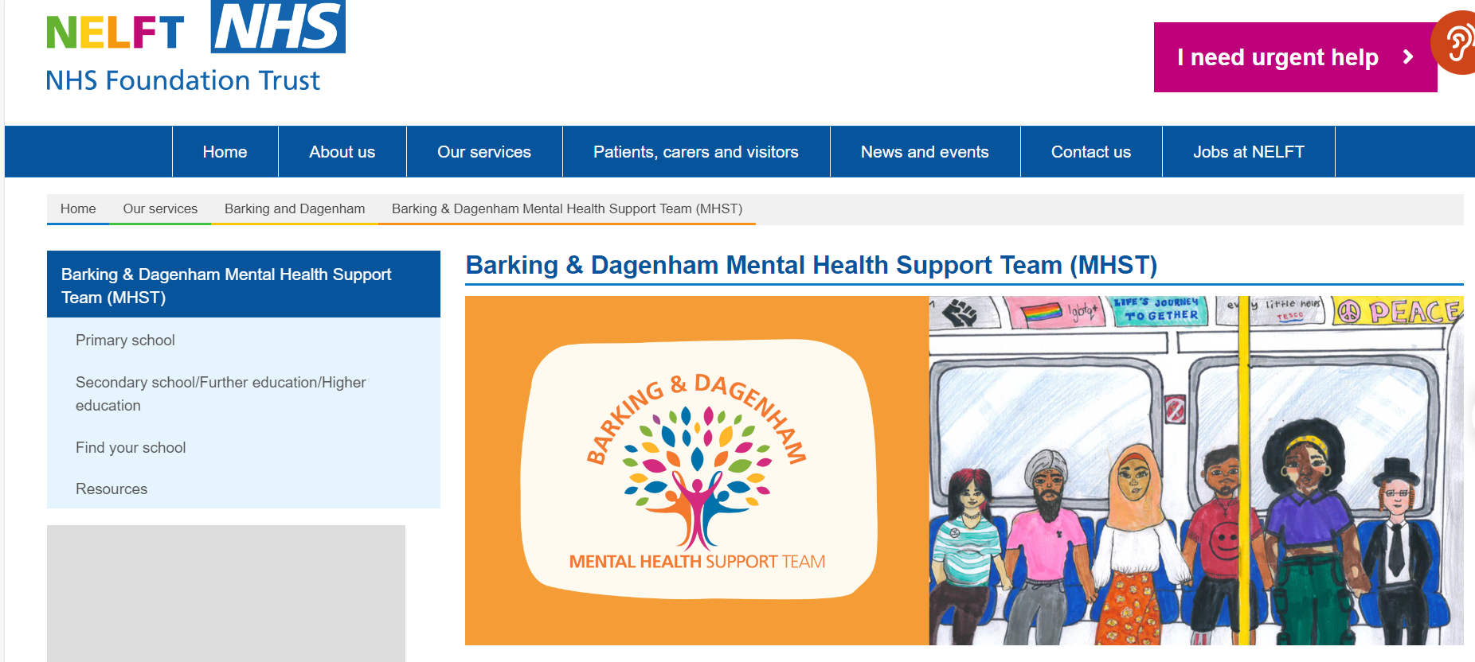
Further information can be found on the B&D MHST webpage
Barking & Dagenham Mental Health Support Team (MHST) | NELFT NHS Foundation Trust

Slide 11
Follow B&D MHST on Instagram
@bdmhst_nelft
Email us with your enquiries
MHST.BD@nelft.uk

