Slide 1
HOME TO SCHOOL TRANSPORT
How it all works

Slide 2
Contextual Setting – School Transport
Increase in demand and corresponding costs
Year | In Borough | Out of Borough | DP / Mileage | Total
19/20 | 388 | 66 | 103 | 557
20/21 | 423 | 66 | 103 | 592
21/22 | 427 | 64 | 130 | 621
22/23 | 451 | 70 | 175 | 696

Slide 3
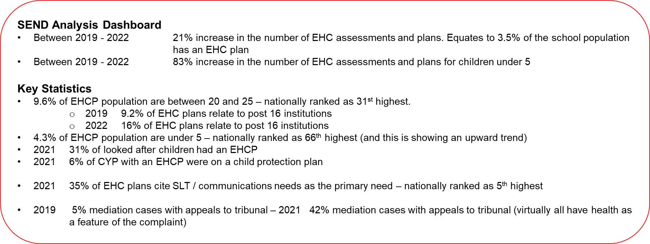
Contextual Setting

Slide 4
Operational Capacity
We have LBBD buses they all have 30 seats; each bus can carry up to 28 children if there are more than 19 children on one bus, they will have 2 passenger assistants. They mostly service pickup points. All crews have full enhanced DBS and full training in Midas and PATS these are refreshed every 3 years.
We have 6 providers that can supply us with Minibuses & Taxi’s all staff are working on behalf of LBBD all have full enhanced DBS and fully trained. The minibuses carry 15 children and 1 passenger assistant.
We have an independent travel training company; they can travel train your child 1:1 over 12 weeks and are very successful and support both the parents and the children throughout the programme. We will only refer year 7 and above.

Slide 5
How it works
We receive your application
The application is processed, and a decision is made on eligibility in line with the HTS policy.
This can include asking for more information from yourself, speaking with the EHC team, speaking to the school – this all takes time!
Once a decision has been made, we then write directly to the parent/carer with the outcome.
Depending on the offer travel starts on the date given or start of the school term - travel cannot commence without the EIF, this is really important to return it keeps your child safe while on transport.
Each year you must reapply for travel assistance, if you do not then we will presume you no longer require travel support, and nothing will be put in place for your child.
Late applications are only accepted in exceptional circumstances. We commission buses and taxis once we have the final numbers we require – if your application is late (and there are no exceptional reasons given), we may not be able to source another vehicle therefore we cannot offer this to you. It will be our discretion to offer any travel support.

Slide 6
Day to day
All buses are routed to a specific route
All crews are instructed by us on how this is to be carried out and in what order.
They are unable to make any changes if a parent asks them to.
The crew aim to arrive on time, they will only wait 3 mins and leave if you do not come out to the bus/taxi.
The borough buses have CCTV and trackers fitted all taxis have trackers and we can check those to see if they leave any areas earlier than they should, we normally find they haven’t and the parent is late, we will not send them back, please leave a few minutes earlier it's better to be early than late!
We cannot change the times of pickups and drop offs to suit other children being collected, we have a bus full of children that want to get home and cannot kris cross the borough!

Slide 7
Day to day
We ask that you are home or at the pickup point at the times given, there is no place of safety any longer therefore your child has to stay on the bus until you arrive.
We also ask any parent going to the pickup points to have your pass, they will not hand your child over even if they know you, take a picture of it on your phone then you will always have it!
We appreciate that at times we are late but unfortunately there will always be traffic the A13 is known for it and this can cause the borough at times to come to a standstill, these are buses and taxis they have to follow the rules of the road and they must sit in the traffic, whilst we ask, they try and contact everyone, so they are aware they do also have children on the buses that they need to watch so it can be challenging for them.

Slide 8
Behaviours
We have in recent years been experiencing high levels of abuse to crews and the office staff, this includes being shouted at, sworn at and even being threatened, this is from parents, we will not tolerate this we at LBBD have a zero-tolerance policy and we will enforce it.
Some children’s behaviours on the bus are challenging, the crews are fully trained to help keep your child calm but at times this is not possible, we will then ask for strategies from the parents and the school, if there are none then we have no option but to offer another form of transport.
Some children do not like the buses they are often loud and noisy, they make frequent stops and can get caught in traffic! Some children do not like having to wear a seat belt – it’s the law and we must abide by it; all of this can cause a sensory overload to a child and make the whole experience unpleasant; it just isn’t for them ☹
We get it you’ve had a bad night, a struggle getting ready in the morning and rushing to do a million things, but if a child is resisting the bus, then it could be them telling you they really don’t like it.

Slide 9
What to expect from us
We aim to be on time and ensure every child/young person gets from home to school and back again in a safe and pleasant environment.
All crews to remain professional and polite throughout their duties.
They will act upon any incidents they come across. We will investigate anything they report including viewing the CCTV so we can get a clear picture of what is happening on the bus.
They will communicate with you anything they feel you need to know.
They are not allowed to pass on information to teachers – the children have books/diaries for you to pass and receive messages from school please use these.
Medication – this must only go on the bus with prior authorisation from the commissioning team.

Slide 10
Finally – the office details
The transport office is open from:
7am – 10.30am
2pm – 5.30pm
The phone number is 0208 227 2713
We will only answer during the times above please leave a message if calling in between and we will get back to you
The email is transport.request@lbbd.gov.uk

