Slide 1


Just Say annual Conference
5thMarch
2025
Welcome

Slide 2

Let’s be kind let’s work together let’s make a real difference

Slide 3

Our Programme
WELCOME
What the forum has been doing on your behalf – Jaime (Chair).
Stallholders to all say HELLO
“Children and Young People’s Rights” - Emma Sparrow
Local Health Services - Denise Edwards
Refreshments & Marketplace
TABLE TALK – your chance to share
What Is Happening in Barking & Dagenham – Elaine Allegretti , Jane Hargreaves & colleagues
Recap & Thanks – Jaime (Chair) & Just Say Steering Group.
TRINITY ROCK BAND performance
Lunch 1.15 - 2.00
PLEASE DO give us your Feedback.

Slide 4

We listened
We produced our Flyer in several community languages
We have a TRANSLATE button on our website www.justsayforum.online
We asked you to fill out a Survey about your experiences so we could share this with the Ofsted Inspectors - 23 of you replied .Thank You.
We have been out to many community spaces to let everyone know about the Forum such as Marks Gate & Barking Family Hub
We responded to your requests for training by working with key partners such as Sycamore, ADDup & BDSIP to deliver 7 sessions, supported by the LA.
Got along to Coffee Mornings at Trinity and CYPC
We have agreed to set up a regular six weekly Surgery at Axe Street

Slide 5

Highlights in Our year
Continued our partnership with
Held 3 Open Forum meetings on Short Breaks/Direct Payments, Transition & Sound Therapy
The Steering Group(SG) continued regular meetings with colleagues from the Council & Health – had 10 in total always raising your issues and concerns
Kept in regular touch with our members via FaceBook Group and Text, increased FB by over 70 members
7 trainings sessions in partnership with the LA - variety of topics and trainers. Over 90 places taken up.
Networked across London with other Parent Carer Forums via emails and by attending 4 Cluster meetings
Attended Annual
Conference

Slide 6
Highlights in Our year
Co-production work
Attended 11 SEND Area Partnership Boards & 2 Away Days
2 meetings to discuss Speech & Language therapy ( SALT) – more meetings to follow
Post 16 – 2 Away Days, Post 16 Strategy and first draft of POST 16 Booklet
On recruitment Panel for Education, Health & Care Plan Manager plus the SG worked on EHCP Quality Assurance
Local Offer. Worked closely with Gigi and colleagues, exchanging information, articles in LO newsletter, supporting outreach in Riverside, Trinity and Barking Family Hub
Presented the Parent Carer’s perspective at a Safeguarding Conference, another meeting at the Town Hall and at the Inclusion Conference – which lead to a meeting with SENCOs

Slide 7
Highlights in Our year
Co-production work
Attended the launch of the CYPD centre, a
Transition Meeting and 2 Careers Fairs –organised by AbPhab
Spoke at Learning Disability & Autism Conference – this led to co-producing a LD & Autism Strategy ( 18+) with the Autism Strategy Board
Attended 5 training sessions delivered by CONTACT – the charity that supports the 150 forums across England on parent carer participation.
“I liked hearing about support when my child turns 16”
“Important information shared”
“All the information I received & discussed
was very useful”
Some Feedback

Slide 8
Parent & Carer
Speech therapist
IT Support
Personal hygiene
Administrator
Decision maker
Navigator
Communicator
Physical and psychological protection
Resilience
Physio
Teacher
Relationship Builder
Dietician
O.T
Travel assistant
Navigator
Sister/Brother
Confidence development
Designated safeguarding lead
Cook
Protector
Nurse
Welfare
Organiser
Spouse
Son/Daughter
Cleaner/maid
Shopper
Sexual health
Life Coach
Preparing for adulthood
Timekeeper
Homekeeper
Health and safety
Grandparent
Appointment maker
Feminine Hygiene
Detective
Decision maker
Advocate
Custody
Emotional supporter
Banking & finances
Employer/employee
Guide
Safe relationships
Supervision

Slide 9

We hope you will get a lot out of today. We are delighted to see so many old friends & some new faces too. We are grateful to the people who help us run the Forum and to all our partners.
TODAY on your tables please share what the important issues are for you and your family. Fill out our POSTCARDS.
Let’s kick off by hearing from Emma
about the Rights of Children & Young People.

Slide 10


We need you!
Join us on Facebook – get along to our Open Forum meetings & Training. Spread the word!
Please reply when we ask for your views. This really helps us get the message across. Fill out Surveys we post on FaceBook. We have strength in numbers.
Help us run the Parent Carer Forum. We have parent carer vacancies on our Steering Group plus 2 places for allies/colleagues (as non-voting members).
We love hearing your IDEAS
& How we can ALL make things BETTER.
263 members
Remember we are here to represent ALL families in BARKING & DAGENHAM where a child or young person is aged 0-25 years living with any disability or additional need.

Slide 11
Thanks to all.
Speakers, Trinity Rock Band, Stallholders, Volunteers, Caterers, Chris and his team at the Football Club & YOU!
Help us improve by giving us your feedback.
Please do join us throughout the year & see you at next year’s Conference.

Slide 12
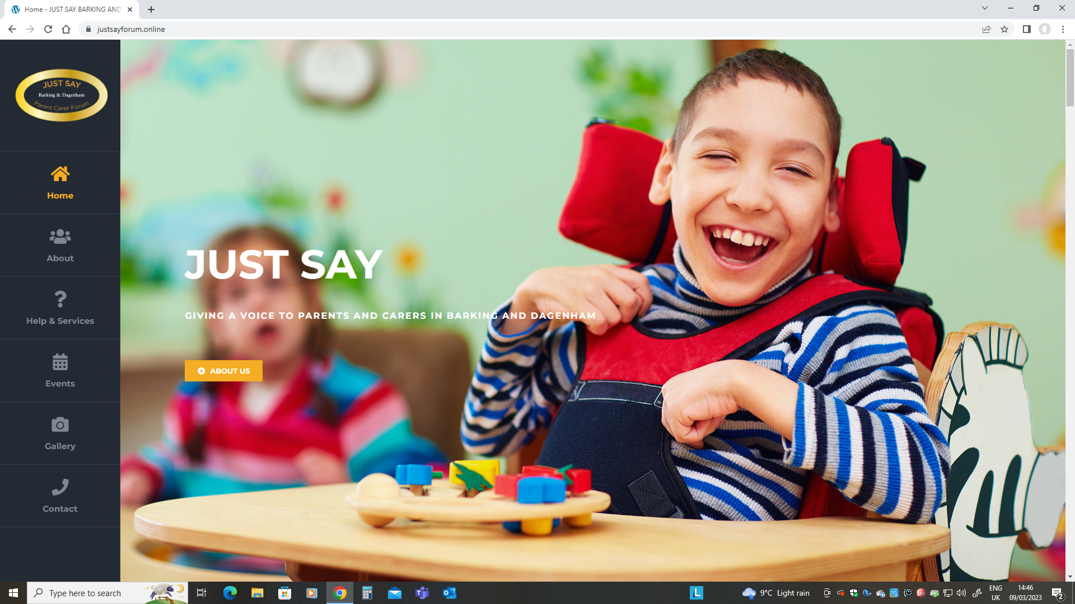
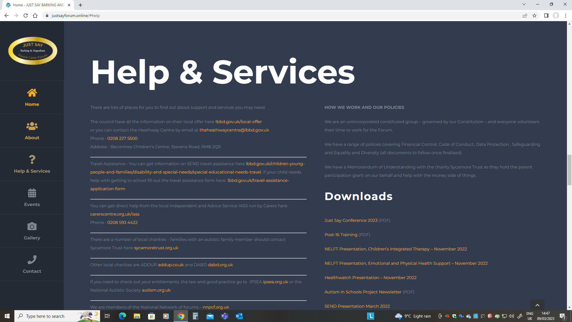
Visit our website www.justsayforum.online
View our upcoming Events
Check out our Policies
Find useful Presentations from partners
See records of our Meetings
Find links to Help & Services
Become a Member
Contact Us

